Slide 1
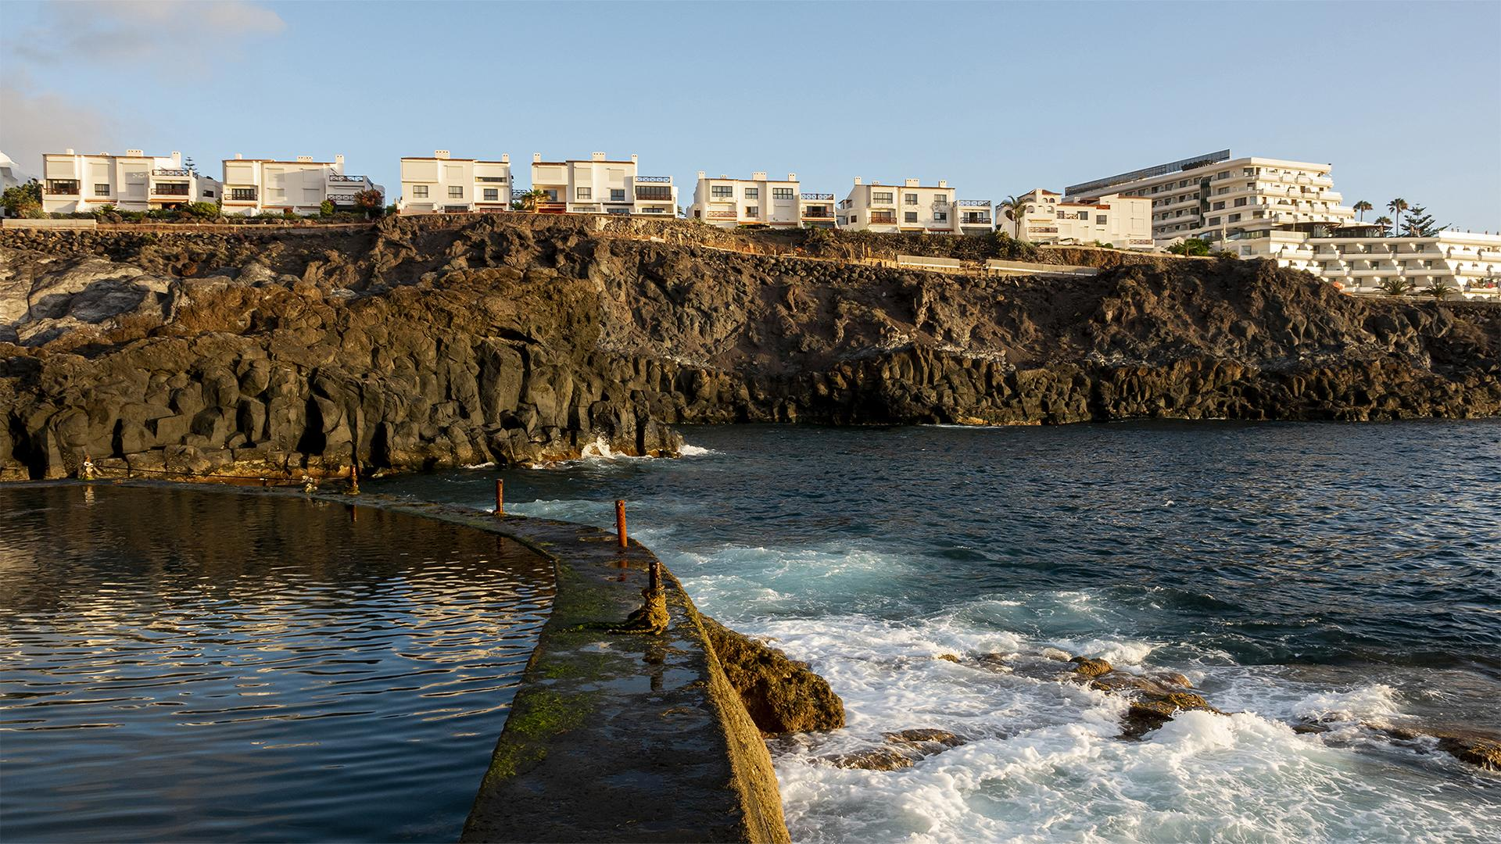
HOTEL ROOM BOOKING WEBSITE
BY
21CS017
21CS059
21CS053

Slide 2
HOTEL CHAIN
TABLE OF CONTENTS
·01·
·02·
·03·
·04·
SINCE 1930
Introduction
Objectives
Features
User Flow

Slide 3

HOTEL CHAIN
Introduction
01
SINCE 1930

Slide 4
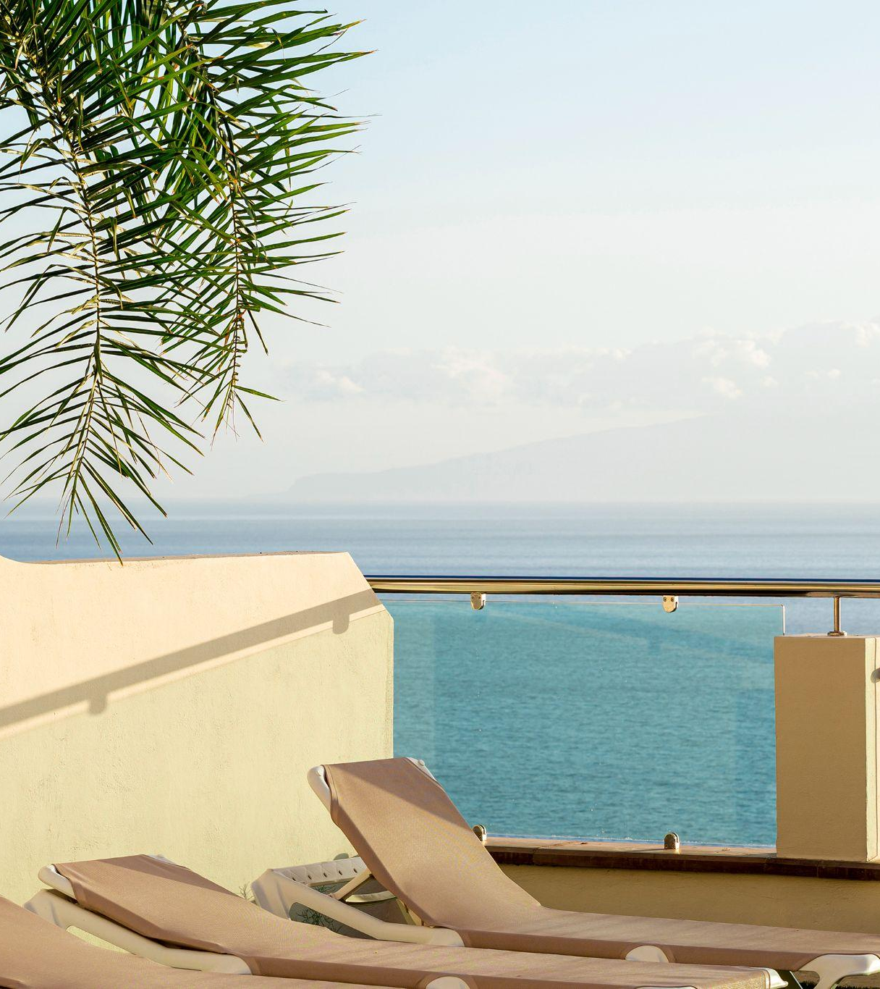
HOTEL CHAIN
SINCE 1930
Finding the right accommodation can be challenging for travelers, especially when considering factors like budget, location, and amenities. Traditional booking platforms often present too many options without adequate filtering, making the process time-consuming and overwhelming.
Our website simplifies the hotel booking process by providing travelers with an intuitive platform to filter accommodations by budget and location. With features like detailed hotel descriptions, and streamlined booking, we aim to create a hassle-free experience that helps travelers find their ideal accommodations quickly and easily.

Slide 5

·02·
Objectives
HOTEL CHAIN
SINCE 1930

Slide 6
HOTEL CHAIN
Key Objectives
SINCE 1930
Enable user registration and login
Display cities
Allow users to filter hotels by budget
Provide a secure checkout

Slide 7

·03·
Features
HOTEL CHAIN
SINCE 1930

Slide 8

Features
HOTEL CHAIN
User Registration & Login: Secure account creation and login system.
City & Hotel Browsing: Browse travel destinations and hotels within each city.
Filter by Budget: Search hotels that meet budget preferences.
Detailed Hotel Pages: View hotel details, images, and amenities before booking.
Secure Checkout: A simple and secure booking process for peace of mind.
SINCE 1930

Slide 9

·04·
Data flow
HOTEL CHAIN
SINCE 1930

Slide 10
HOTEL CHAIN
SINCE 1930
Sign up/ Login
Select City
Filter hotels based on check-in, check-out date, and budget
Select hotel and view details
Book

Slide 11
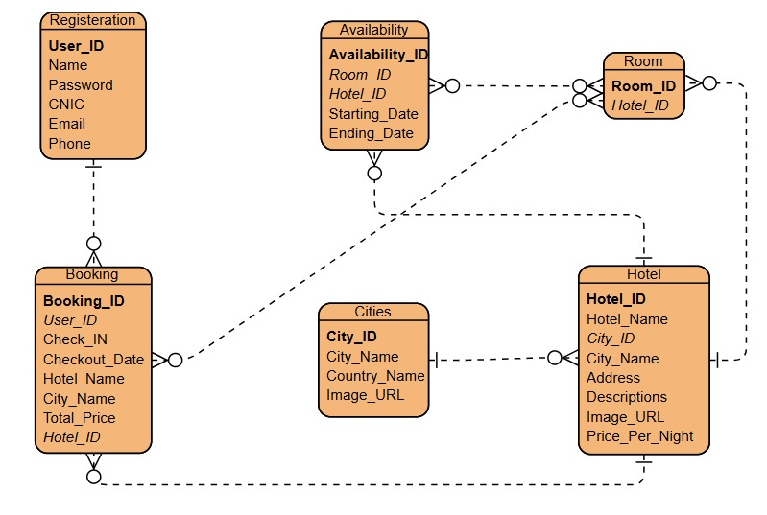
HOTEL CHAIN

Slide 12
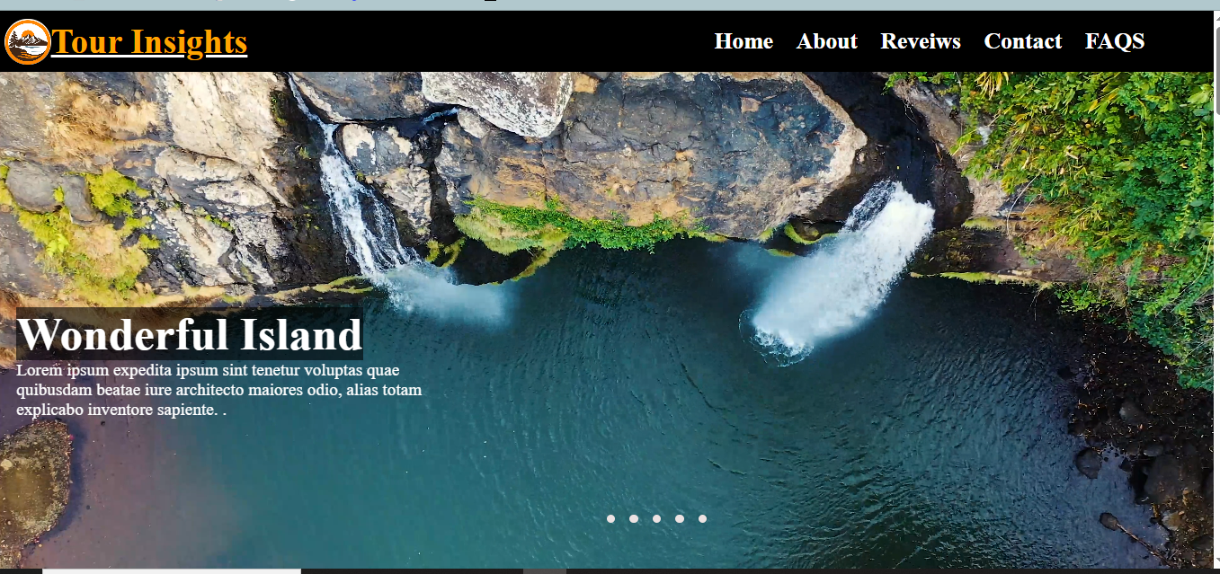
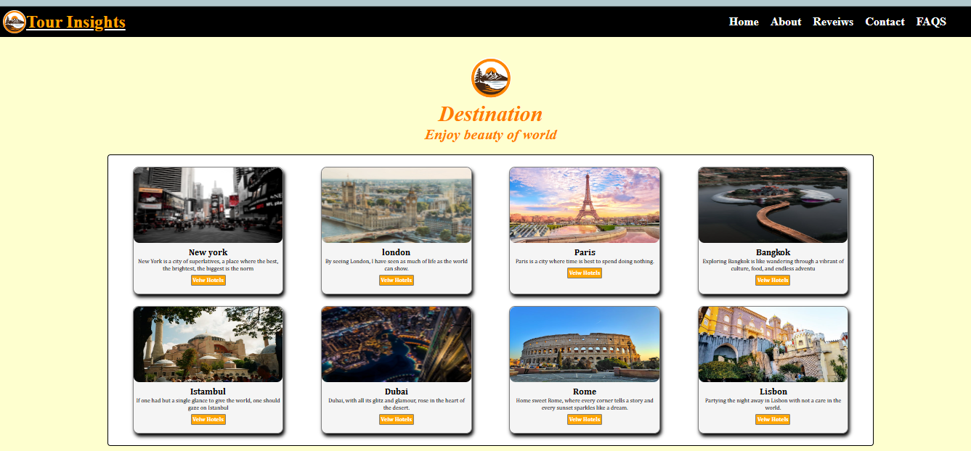
HOTEL CHAIN
Interface

Slide 13
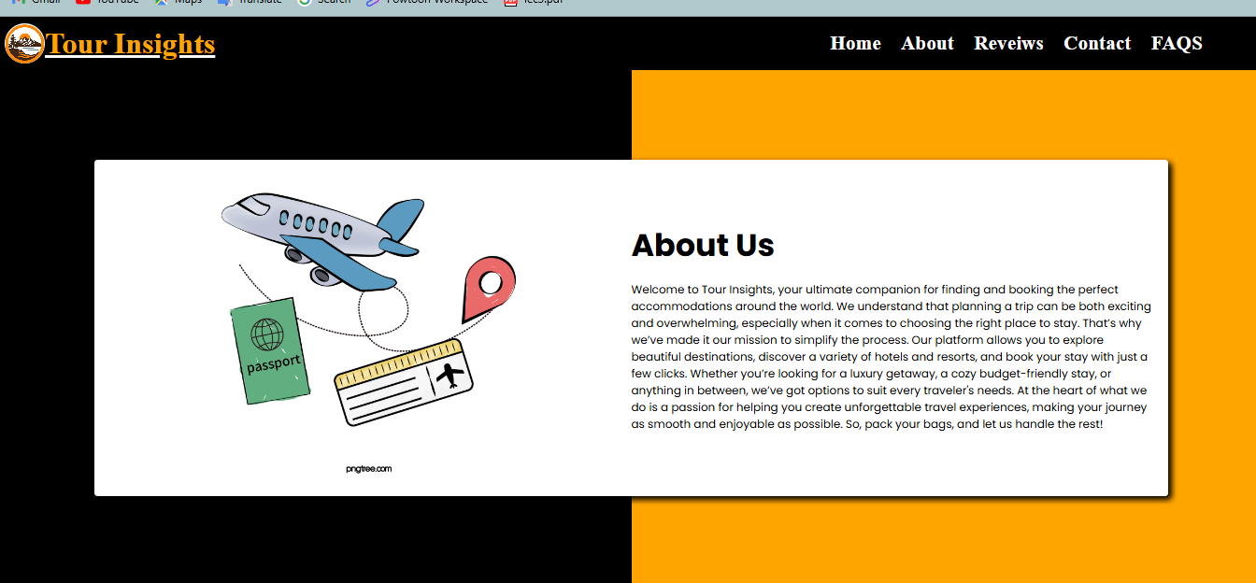
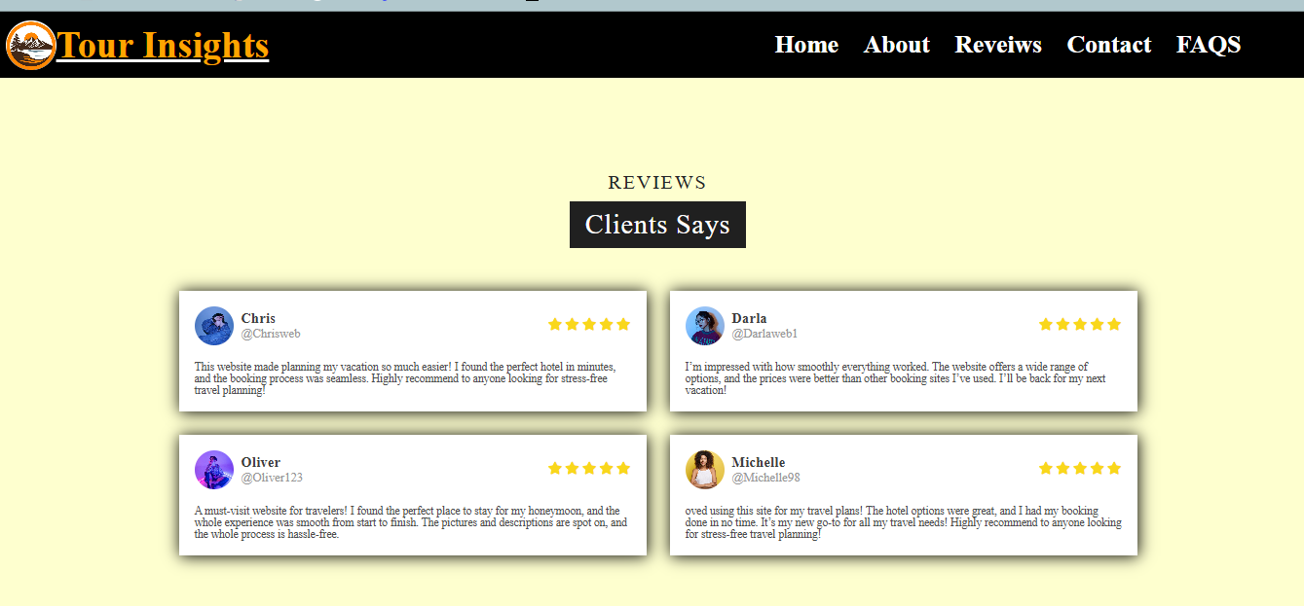
HOTEL CHAIN

Slide 14
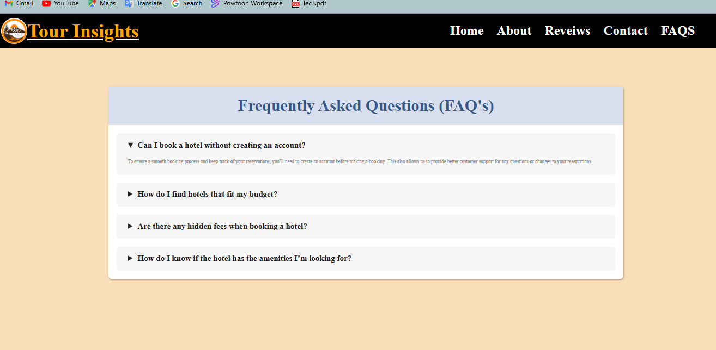

HOTEL CHAIN

Slide 15
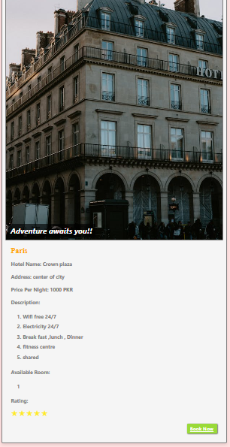
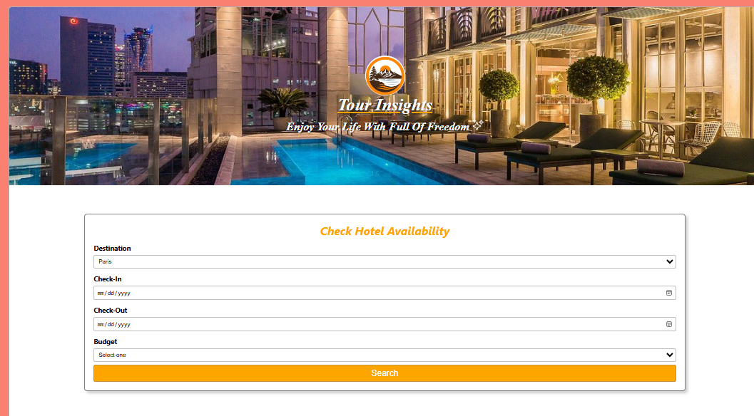
HOTEL CHAIN

Slide 16
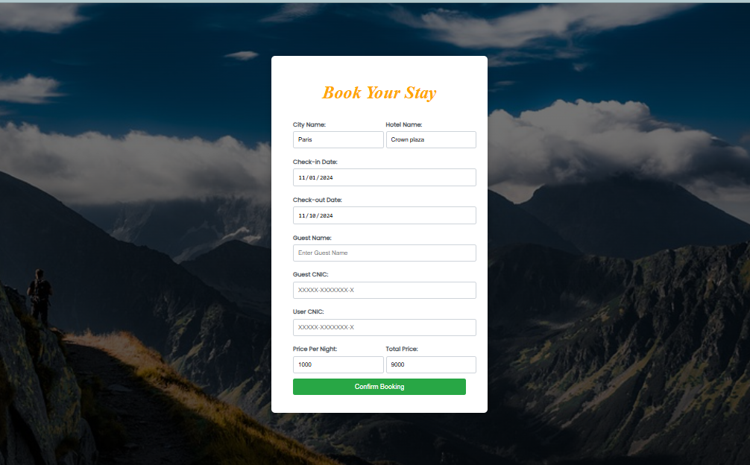
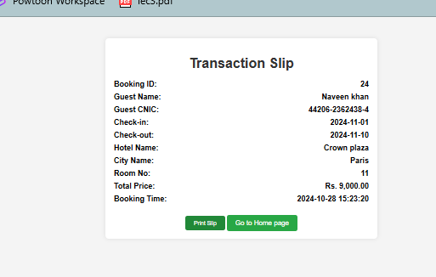
HOTEL CHAIN

Slide 17
THANKS!

